Slide 1
ARTIFICIAL NEURAL NETWORK AND DEEP LEARNING Deep Reinforcement Learning
Dr Somesh Nandi
Assistant Professor
Dept of AIML
RVCE

Slide 2
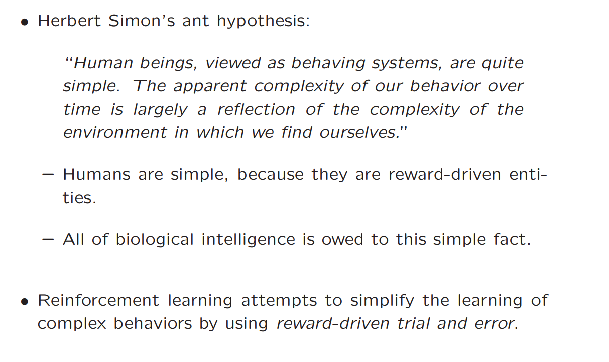
Deep Reinforcement Learning

Slide 3
Deep Reinforcement Learning
Human beings are considered simple because they are one-dimensional, selfish, and reward driven entities (when viewed as a whole), and all of biological intelligence is therefore attributable to this simple fact.
Since the goal of artificial intelligence is to simulate biological intelligence, it is therefore natural to draw inspirations from the successes of biological greed in simplifying the design of highly complex learning algorithms.

Slide 4
Deep Reinforcement Learning
A reward-driven trial-and-error process, in which a system learns to interact with a complex environment to achieve rewarding outcomes, is referred to in machine learning parlance as reinforcement learning.
In reinforcement learning, the process of trial and error is driven by the need to maximize the expected rewards over time.
Reinforcement learning can be a gateway to the quest for creating truly intelligent agents such as game-playing algorithms, self-driving cars, and even intelligent robots that interact with the environment.

Slide 5
Deep Reinforcement Learning
Example 1 : Atari 2600 is a platform supporting multiple games.
The input to the deep learner from the Atari platform is the display of pixels from the current state of the game.
The reinforcement learning algorithm predicts the actions based on the display and inputs them into the Atari console.

Slide 6
Deep Reinforcement Learning
Example 2 : AlphaGo : to play the game of Go by using the reward-outcomes in the moves of games drawn from both human and computer self-play.
Go is a complex game that requires significant human intuition, and the large tree of possibilities (compared to other games like chess) makes it an incredibly difficult candidate for building a game-playing algorithm.
AlphaGo has not only convincingly defeated all top-ranked Go players it has played against , but has contributed to innovations in the style of human play by using unconventional strategies in defeating these players

Slide 7
Deep Reinforcement Learning
Example 3 : Self Driving Cars
In recent years, deep reinforcement learning has been harnessed in self-driving cars by using the feedback from various sensors around the car to make decisions.
Although it is more common to use supervised learning (or imitation learning) in self-driving cars, the option of using reinforcement learning is more accurate.
During the course of driving, these cars now consistently make fewer errors than do human beings.

Slide 8
Deep Reinforcement Learning
Example 4 : Multi armed Bandit problem
Imagine a gambler in a casino with many slot machines (also called "bandits").
Each machine gives a reward, but you don’t know in advance which machine gives the most rewards.
To win as much as possible, you need to:
Explore: Try different slot machines to figure out which ones pay well.
Exploit: Keep playing the machine you think gives the best reward.
The Challenge:
Exploring new machines might help you learn more, but it could also waste money if the machine doesn’t pay well.
Exploiting what you’ve already learned gives rewards but might miss better options.
The goal is to balance exploration (trying new things) and exploitation (using what you know works).

Slide 9
Deep Reinforcement Learning
Stateless Algorithms: Multi-Armed Bandits- Solutions
Naïve Algorithm
The gambler tries each slot machine a certain number of times to figure out which one pays the best (this is called exploration).
After testing, they pick the machine they think is best and use it forever (exploitation).

Slide 10
Deep Reinforcement Learning
Stateless Algorithms: Multi-Armed Bandits
Drawbacks :
Hard to Decide When to Stop Testing: How many times should you try each machine to be sure which one is the best? It’s not clear.
Takes Too Long: If rewards are rare (like a machine that only gives big wins occasionally), it might take forever to figure out which machine is best.
Wasted Effort: Testing too much wastes time and effort on bad machines.
Big Mistake if Wrong: If you pick the wrong machine, you’re stuck with it forever, and you’ll keep losing out.

Slide 11
Deep Reinforcement Learning
Stateless Algorithms: Multi-Armed Bandits
Method 2: ∈-Greedy Algorithm
The basic idea is to choose a random slot machine for a fraction ∈ of the trials.
These exploratory trials are also chosen at random (with probability ∈) from all trials, and are therefore fully interleaved with the exploitation trials.
In the remaining (1 − ∈) fraction of the trials, the slot machine with the best average payoff so far is used.
Advantage : one is guaranteed to not be trapped in the wrong strategy forever.
Since the exploitation stage starts early, one is often likely to use the best strategy a large fraction of the time.

Slide 12
Deep Reinforcement Learning
Stateless Algorithms: Multi-Armed Bandits
Method 2: ∈-Greedy Algorithm
The goal is to balance exploration (trying different slot machines) and exploitation (sticking to the best one).
Here’s how it works:
For a small fraction of the time (∈, like 10% or 0.1), the gambler picks a random slot machine to try something new (exploration).
For the rest of the time (1− ∈, like 90% or 0.9), they stick with the machine that has given the best average reward so far (exploitation).
Why This Works:
Random exploration (∈ fraction) ensures the gambler keeps learning and doesn’t get stuck using the wrong machine forever.
Starting exploitation (1− ∈ fraction) early ensures the gambler spends most of the time using the best machine.

Slide 13
Deep Reinforcement Learning
Method 3: Upper Bounding Methods
The upper bounding strategy improves this by combining exploration and exploitation into every trial.
Here’s how it works:
Optimistic View:
Instead of only using the reward (mean) of a slot machine to decide, the gambler adds a "bonus" for uncertainty.
This bonus is bigger for slot machines that haven’t been tested much.
Formula for Decision:
The upper bound (Ui) for a slot machine = Average reward (Qi) + Confidence bonus (Ci). So, machines with higher uncertainty (larger bonuses) are more likely to be chosen.

Slide 14
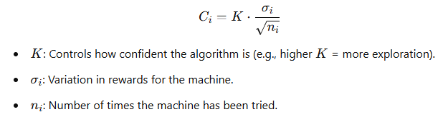
Deep Reinforcement Learning
Stateless Algorithms: Multi-Armed Bandits
Method 3: Upper Bounding Methods
Confidence Bonus (Ci):
Ci depends on how many times a slot machine has been tried:
Rarely tried machines → Higher uncertainty → Larger bonus → More exploration.
Frequently tried machines → Lower uncertainty → Smaller bonus → More exploitation.
Formula for Ci:

Slide 15
Stateless vs. State-Based Learning
Stateless Algorithms (like bandit algorithms):
Each decision (action) is made independently of the past.
Past actions only update the agent's knowledge (e.g., which slot machine gives better rewards).
The environment itself doesn’t change based on past actions.
State-Based Learning (in reinforcement learning):
Actions not only update the agent’s knowledge but also change the environment.
The decision depends on the state of the environment, which reflects the result of past actions.

Slide 16
Agent and Environment:
Agent: The decision-maker (e.g., a video game player or a self-driving car system).
Environment: The system or setup the agent interacts with (e.g., the video game world or the road).
Actions and States:
Action: Any move or decision the agent makes (e.g., pressing a button or steering the car).
State: The current situation of the environment, including all relevant variables (e.g., the car's position or the player’s location in the game).
Rewards:
The environment provides feedback (rewards) based on how well the agent is doing.
Rewards aren’t always immediate or tied to a single action.
Example:
Swerving to avoid a crash in a dangerous situation might give a positive reward.
The same swerve in a normal situation might lead to a negative reward.

Slide 17
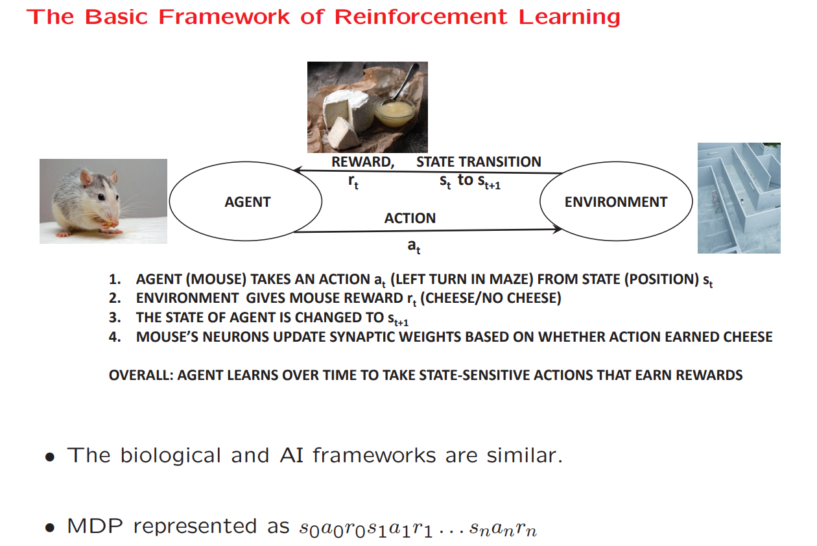
Deep Reinforcement Learning

Slide 18
Basic Framework of Reinforcement
The entire set of states and actions and rules for transitioning from one state to another is referred to as a Markov decision process.
The main property of a Markov decision process is that the state at any particular time stamp encodes all the information needed by the environment to make state transitions and assign rewards based on agent actions.
Finite Number of Actions : Epiosede
Infinite ;Non Eposiodic

Slide 19
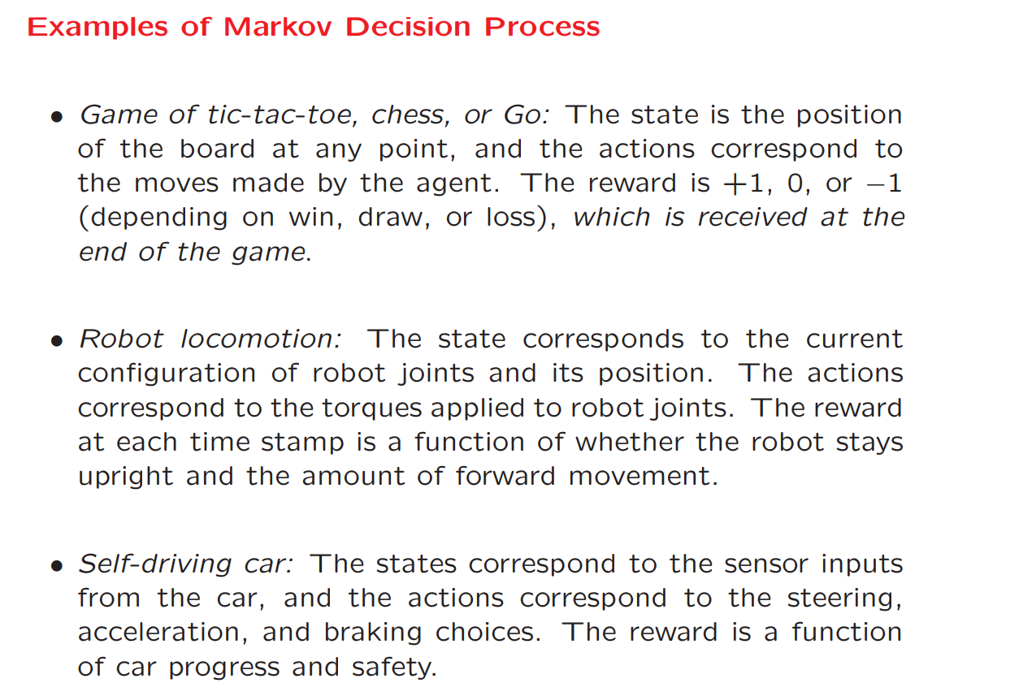
Deep Reinforcement Learning

Slide 20
Deep Reinforcement Learning
Challenges in Reinforcement Learning
When a reward is received (e.g., winning a game of chess), it is not exactly known how much each action has contributed to that reward.
This problem is referred to as the credit-assignment problem.
2. The reinforcement learning system might have a very large number of states, and must be able to make sensible decisions in states it has not seen before.
This task of model generalization is the primary function of deep learning

Slide 21
Deep Reinforcement Learning
Challenges in Reinforcement Learning
3. A specific choice of action affects the collected data in regard to future actions.
Trade-off between exploration and exploitation. If actions are taken only to learn their reward, then it incurs a cost to the player. On the other hand, sticking to known actions might result in suboptimal decisions.
4. Reinforcement learning merges the notion of data collection with learning.
Realistic simulations of large physical systems such as robots and self-driving cars are limited by the need to physically perform these tasks and gather responses to actions in the presence of the practical dangers of failures.

Slide 22
Deep Reinforcement Learning
Challenges in Reinforcement Learning
The inability to gather sufficient data in real settings beyond simulated and game-centric environments is arguably the single largest challenge to reinforcement learning.

Slide 23
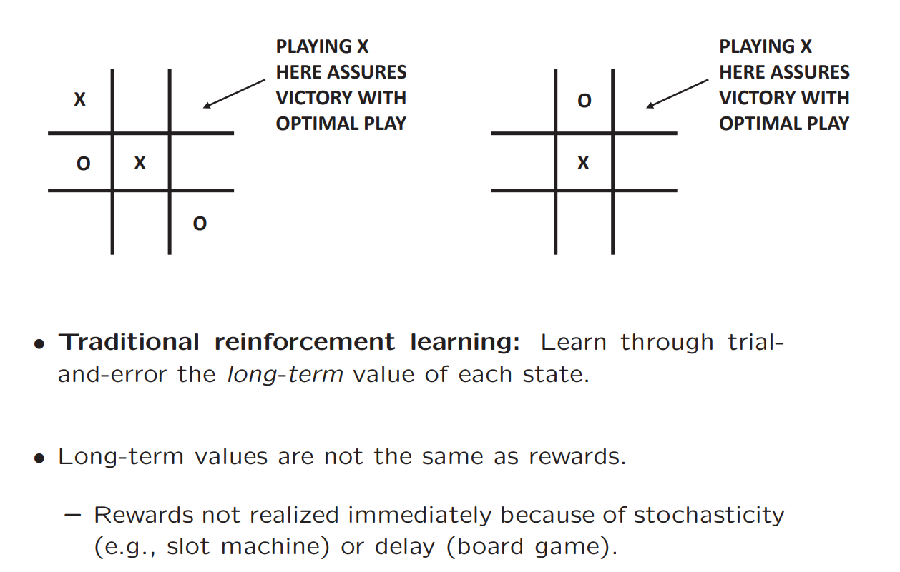
Deep Reinforcement Learning
Tic-Tac-Toe

Slide 24
Reinforcement Learning for Tic-Tac-Toe
Key Steps in Learning Tic-Tac-Toe:
State and Action Representation:
Every board position is a state.
Every valid move (placing 'X' or 'O') is an action.
Number of States:
The 3×3 tic-tac-toe board has at most 19,683 states (3 possibilities for each of the 9 positions: 'X', 'O', or blank).
Learning State-Action Values:
The algorithm keeps track of the value of each state-action pair (s, a):
How good is it to play action a in state s?
These values are learned based on how actions performed historically.

Slide 25
What is a Reward?
A reward is the score or feedback given after a game:
Win: Positive reward (e.g., +1).
Loss: Negative reward (e.g., -1).
Draw: No reward (e.g., 0).
It tells the algorithm how good or bad a move was in achieving the game's goal.

Slide 26
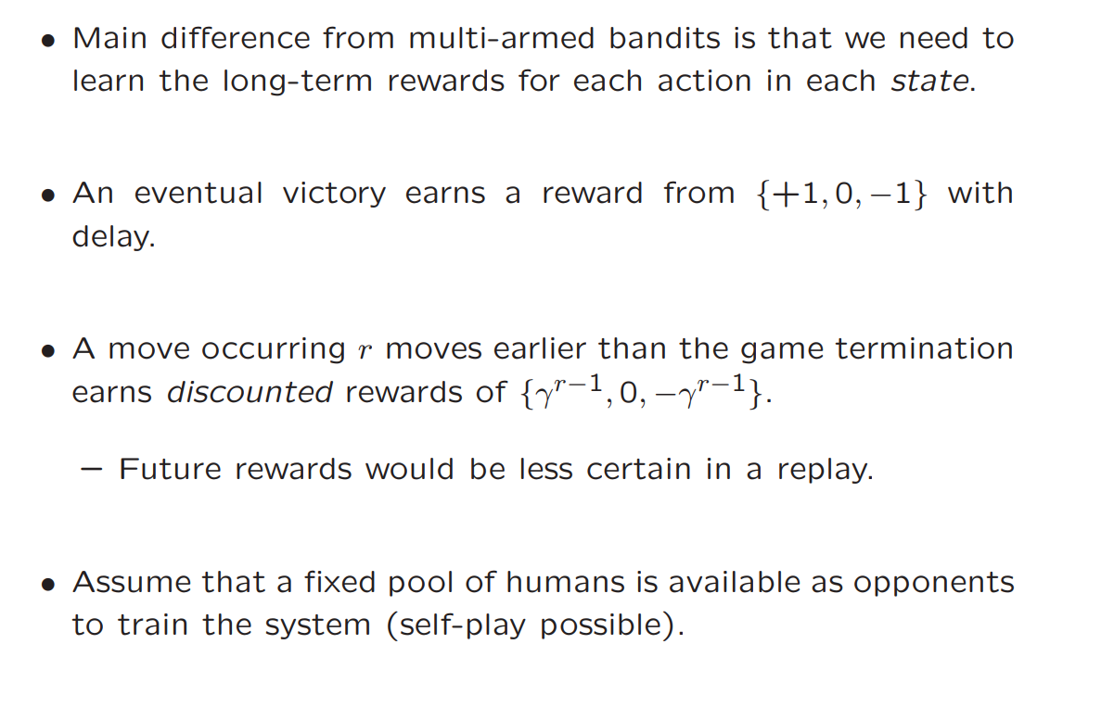
Deep Reinforcement Learning
Tic-Tac-Toe

Slide 27
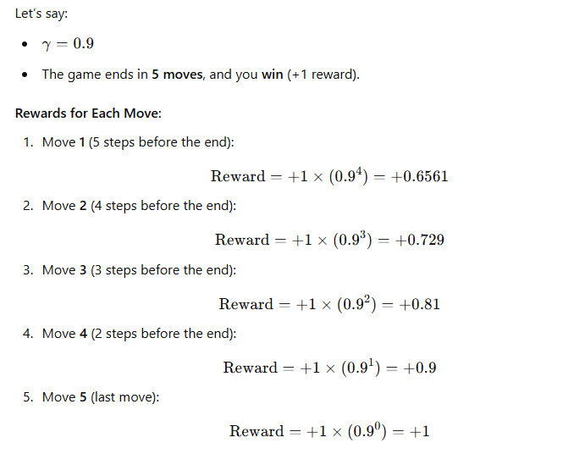

Discounting means reducing the importance of a reward as we go further back in the game.
Earlier moves are more important because they set the foundation for the result.
This is done using a discount factor γ, where 0<γ<1
Actions made closer to the end (e.g., the last move) are directly responsible for the result, so they get a higher reward.
Actions made earlier are less directly connected, but they still contribute, so they get smaller rewards.

Slide 28
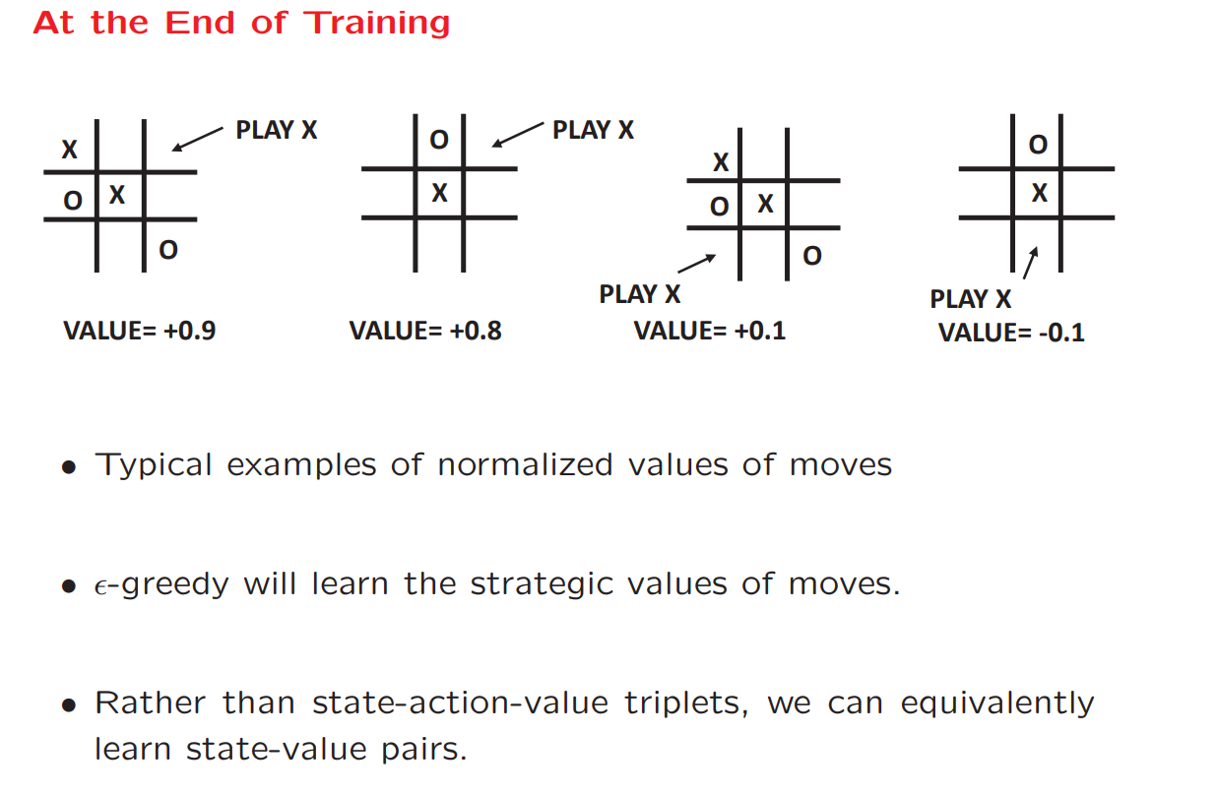
Deep Reinforcement Learning

Slide 29
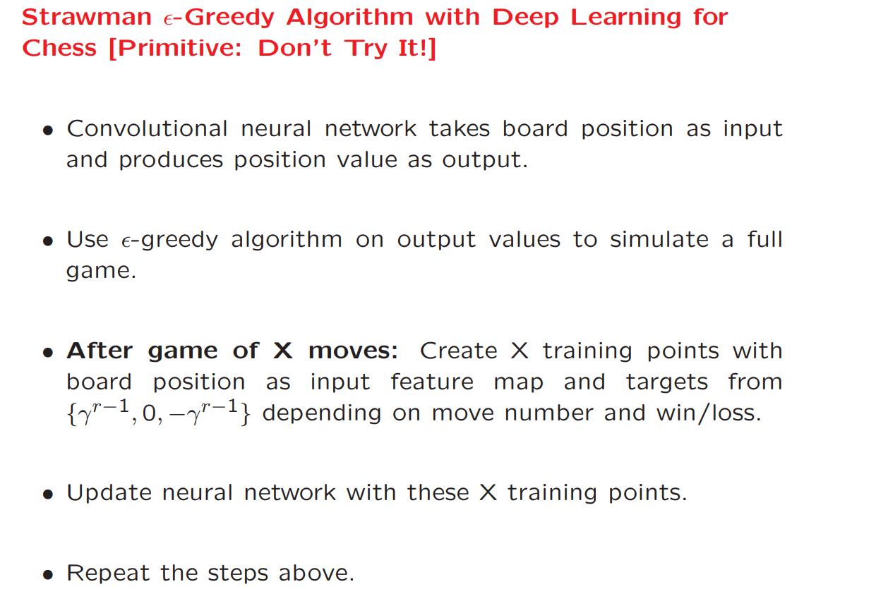
Deep Reinforcement Learning

Slide 30
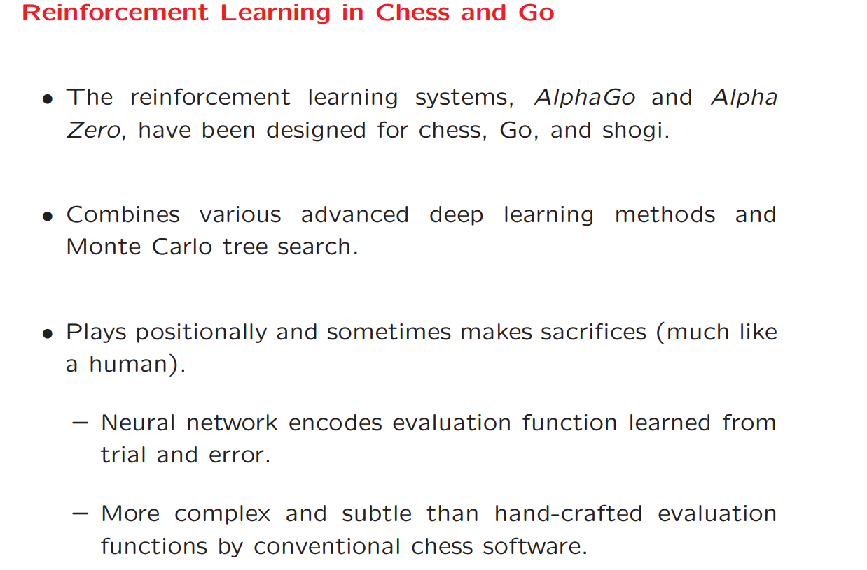
Deep Reinforcement Learning

Slide 31
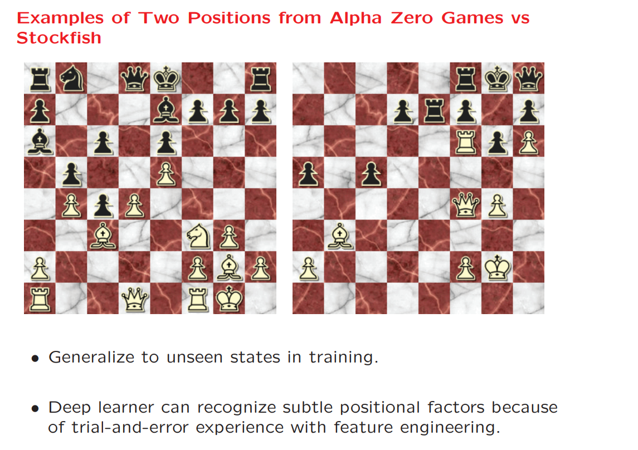
Deep Reinforcement Learning

Slide 32
Straw Man Algorithm in Reinforcement Learning
A Straw Man Algorithm is a simple, naive baseline used for comparison in reinforcement learning.
It’s often implemented to test basic functionality or provide a benchmark for evaluating more sophisticated algorithms.
While not meant to be optimal, it gives an idea of how a basic strategy performs in a given environment.

Slide 33
Straw Man Algorithm in Reinforcement Learning
A 5x5 grid where: The agent starts at the bottom-left corner.
The goal is at the top-right corner.
Moving into a wall keeps the agent in the same position.
Rewards:
Reaching the goal: +10.
Every step: -1 (penalty for taking too long).
Straw Man Algorithm:
Policy: Choose a random action (e.g., UP, DOWN, LEFT, RIGHT) at every step, regardless of the current state.
No Learning: The agent doesn’t update its behavior based on rewards or outcomes.
Termination: Stops when the agent reaches the goal or a maximum number of steps is taken.

Slide 34
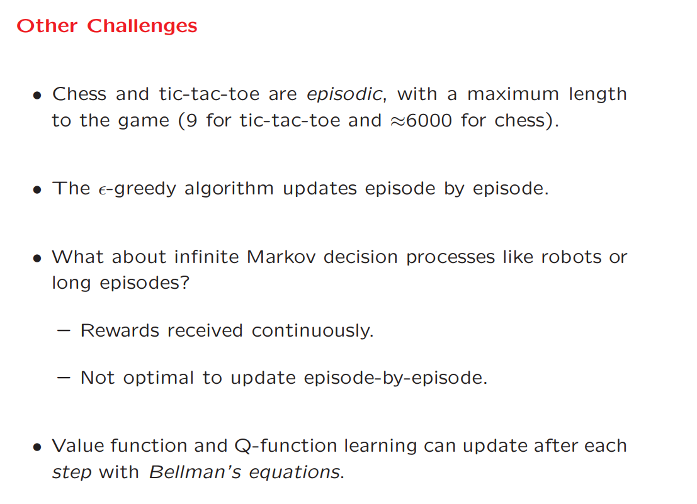
Deep Reinforcement Learning

Slide 35
Boot Strapping for Value Function Learning
Bootstrapping is a technique in reinforcement learning (RL) where an agent updates its knowledge or value estimates incrementally during the learning process, using estimates of future values rather than waiting for the actual outcome.
Bootstrapping is essential for efficient learning in environments where the agent has to deal with long-term decisions, large state spaces, or tasks that may continue indefinitely.
The process of using current progress to estimate future success is exactly what bootstrapping

Slide 36
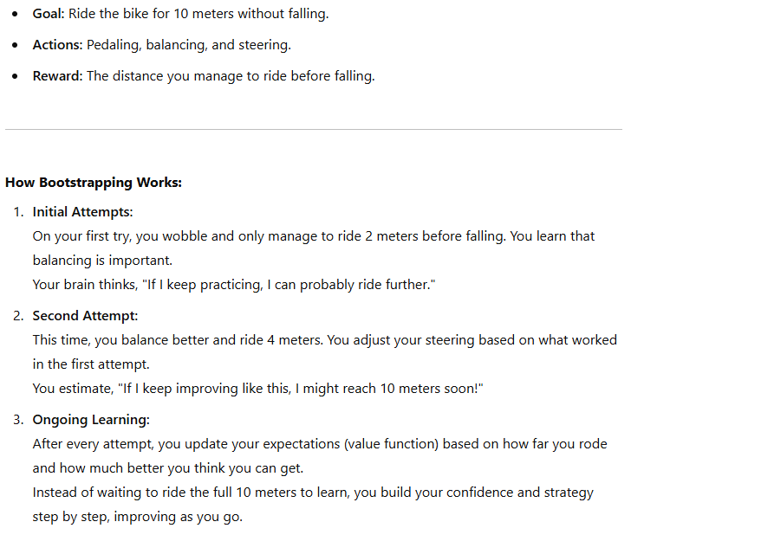
Boot Strapping for Value Function Learning
.

Slide 37
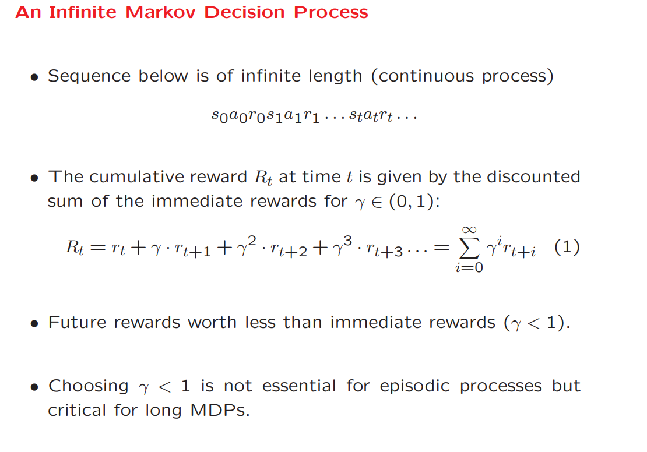

Deep Reinforcement Learning

Slide 38
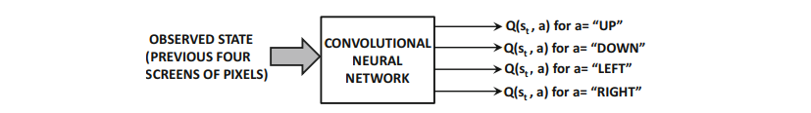
Deep Reinforcement Learning
Deep Learning as Functional Approximator
Consider the Atari setting in which a fixed window of the last few snapshots of pixels provides the state st.
Assume that the feature representation of st is denoted by Xt. The neural network uses Xt as the input and outputs Q(st, a) for each possible legal action a from the universe of actions denoted by the set A.

Slide 39

Deep Reinforcement Learning
Deep Learning as Functional Approximator
Assume that the neural network is parameterized by the vector of weights W, and it has |A| outputs containing the Q-values corresponding to the various actions in A.
In other words, for each action a ∈ A, the neural network is able to compute the function F(Xt, W,a), which is defined to be the learned estimate of Q(st, a):

Slide 40
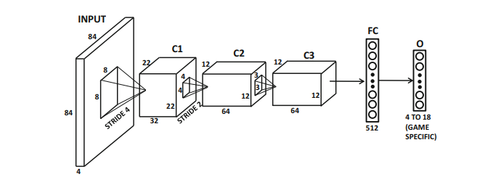
Deep Reinforcement Learning
Example: Neural Network for Atari Setting

Slide 41
On-Policy Versus Off-Policy Methods: SARSA
A policy is the agent's "strategy" or "rulebook" for deciding what action to take in any given situation.
On-Policy Methods:
The agent learns about the policy it is currently following.
It updates its strategy (policy) based on the actions it is actively using to explore the environment.
Key Idea: “Learn by doing
Example:
Imagine learning to ride a bicycle. You're figuring it out as you go—falling, adjusting your balance, and improving. This is on-policy learning because you’re learning while actively using your own approach.

Slide 42
On-Policy Versus Off-Policy Methods: SARSA
The agent learns about a policy different from the one it is currently using to explore.
It might take random actions (to explore better), but it’s learning how to behave if it followed a smarter, more optimized strategy.
Key Idea: “Learn by watching or experimenting.”
Example:
Imagine watching YouTube tutorials on riding a bicycle and practicing based on those tips. Here, you're off-policy because you’re learning about the "ideal" way to ride, even if your current attempts are messy.

Slide 43
On-Policy Versus Off-Policy Methods: SARSA
Q-Learning is a type of off-policy method, while its counterpart, SARSA, is an on-policy method.
Here’s how they differ:
Q-Learning (Off-Policy):
Q-Learning doesn’t care what the agent is currently doing (its current policy).
It learns the best possible policy by always assuming the agent will pick the best action in the future.
Example: Watching someone else’s mistakes or successes and learning from them to create an ideal strategy.
SARSA (On-Policy):
SARSA updates its knowledge based on the actions the agent is actually taking (its current policy).
It focuses on improving the policy the agent is currently using.
Example: Learning while riding your bicycle and improving your balance.

Slide 44
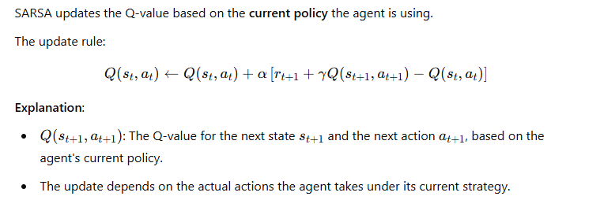
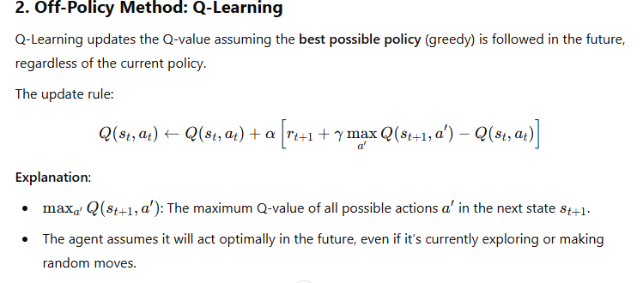
On-Policy Versus Off-Policy Methods: SARSA
Mathematical Representation

Slide 45
Modeling States Versus State-Action Pairs
State:
A state is like the current "situation" or "position" you are in.
Example: Imagine you are playing chess. The current arrangement of the chess pieces is your state.
State-Action Pair:
A state-action pair is when you combine a situation (state) with a decision (action).
Example: In the same chess game, the state could be the chessboard setup, and the action could be "move the queen to D4."

Slide 46
Modeling States Versus State-Action Pairs
Modeling States (Value Function V(s):
Think of this as just rating each situation (state).
Example:
If you’re in a chess state where your pieces are strong, you might give it a value of 80 points.
A bad state where you're losing might get only 20 points.
You just ask: "How good is this situation for me?"
Modeling State-Action Pairs (Q-Function Q(s,a)):
Here, you think about both the situation and the actions you can take.
Example:
In the same chess state, you consider different actions:
Moving the queen to D4 might give a value of 50 points.
Moving a pawn forward might give 30 points.
You ask: "How good is it to take this specific action in this situation?"

Slide 47
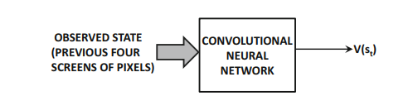
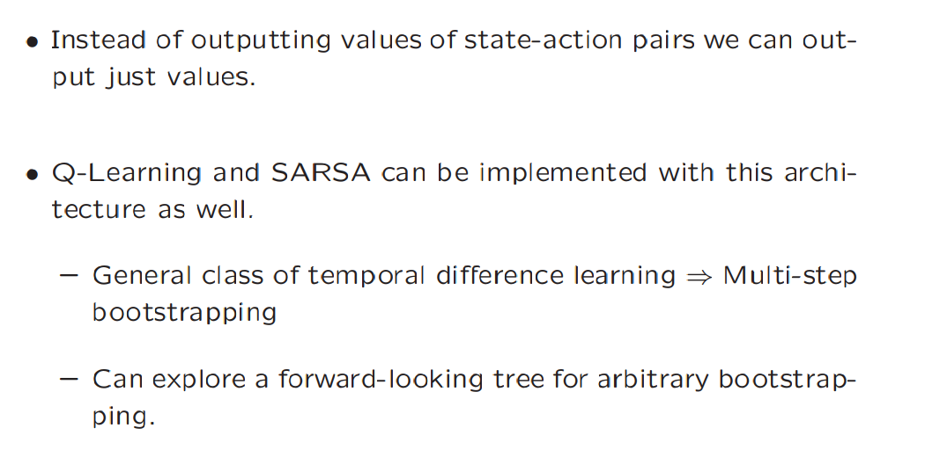
Deep Reinforcement Learning
Modeling States Versus State-Action Pairs

Slide 48
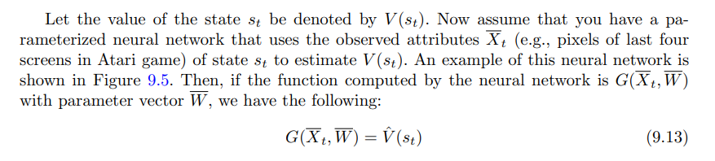
Deep Reinforcement Learning
Modeling States Versus State-Action Pairs
we will assume that we have some reasonable heuristic policy for choosing the actions that uses the forward-looking state values in some way.
For example, if we evaluate each forward state resulting from an action and select one of them based on a pre-defined policy (e.g., ∈ -greedy), the approach is the same as SARSA.

Slide 49
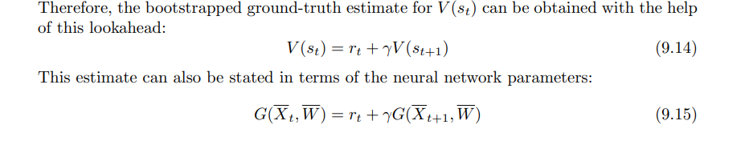
Deep Reinforcement Learning
Modeling States Versus State-Action Pairs

Slide 50
Deep Reinforcement Learning
Monte Carlo Tree Search
Monte Carlo Tree Search (MCTS) is a smart way for computers to make decisions, especially in games or problems where there are many possible moves and outcomes.
How Does MCTS Work?
MCTS is like exploring a decision tree where:
Each node represents a possible situation (state).
Each branch represents an action you can take to move to the next state.
Selection
Expansion
Simulation
BackPropgation

Slide 51
Deep Reinforcement Learning
Let’s imagine you’re in a huge toy store, and you want to find the most fun toy. You don’t have time to play with all the toys, so you need a plan.
Selection:
Start from the current situation (root node).
Pick the most promising child node (action) to explore, using a strategy like UCB1 (Upper Confidence Bound for Trees).
Example
You start by looking at a shelf full of toys.
You pick the toy that seems most fun based on what you’ve tried before.
Example: If a robot toy was fun before, you might choose a similar one.

Slide 52
Deep Reinforcement Learning
Expansion:
If the chosen node isn’t fully explored, create a new child node.
This represents trying a new action.
If you see a new toy on the shelf, you decide to try it out.
Example: You’ve never played with a remote-controlled car, so you give it a chance.
Simulation:
From the new node, simulate a random sequence of actions until the game ends (or a predefined point).
You take the toy and play with it for a little while.
Example: You race the remote-controlled car around the store to see if it’s fun.

Slide 53
Deep Reinforcement Learning
Backpropagation:
Use the result of the simulation to update the value of the nodes that were part of the path.
If a simulation ends in a win, all nodes along the path to that win become more favorable.
Backpropagation:
After playing, you decide how much fun it was and remember it.
If it was super fun, you’ll want to play with it again. If not, you’ll avoid it next time.

